Slide 1

Assessing the Thermochemical Properties of Organometallics
Andrew Devlin
Purdue University – Johnson Matthey
5/19/2026

Slide 2
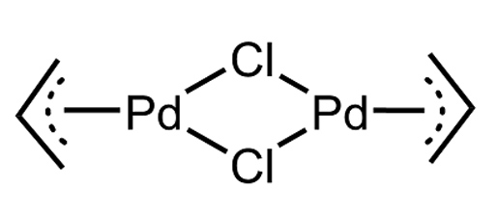

Organometallics
Molecules which contain one or more Carbon-Metal bonds
Unique reactivity and charge properties which allow for use as catalysts
Johnson Matthey (JM) produces many types of organometallics for the agrochemicals and pharmaceuticals industries
Common metal centers include palladium, platinum, iridium, etc.
Palladium allyl chloride dimer, a molecule of interest during this study

Slide 3
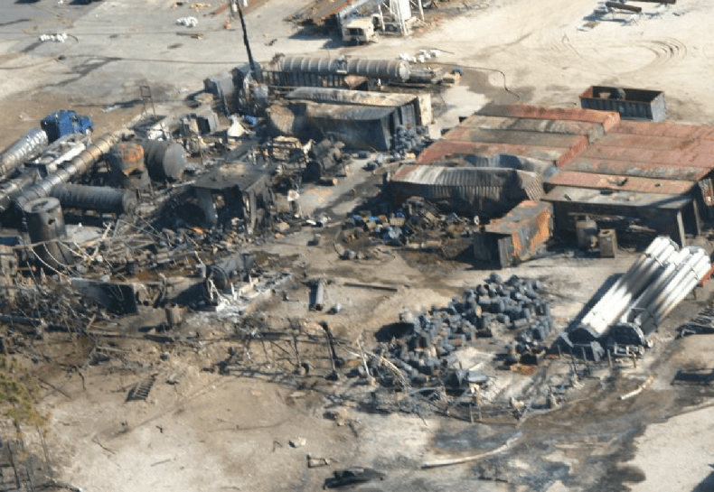
Motivation
It is critical to understand heat of reaction (ΔH_{rxn} ) to ensure safe process scale-up
ΔH_{rxn} is difficult to measure. So, use heat of combustion (ΔH_{c}) instead
Typically, direct testing methods such as bomb calorimetry are used
However, organometallics are very expensive: $1500-2000 per test, ~500 products in JM's Catalog
An accurate theoretical method of estimating ΔH_{c} would be highly valuable to JM
December 7, 2007: An explosion at T2 Laboratories in Jacksonville, FL kills 4 and injures 32 – directly contributable to insufficient process scale-up knowledge

Slide 4
Previous Work
Where was this project when I inherited it?
Previously, TCIT investigated as a thermochemical estimation tool:
1. DFT
Used for modeling of metal centers in organometallics
Not as accurate for ligands (carbon-based surroundings)
2. G4
More accurate for ligands
Cannot handle metals due to missing basis sets
Computationally expensive
TCIT = DFT(Metal) + G4(Organic)
Showcased good accuracy, but process was cumbersome and time consuming
Instead, try using DFT to model the whole molecule!

Slide 5
Density Functional Theory (DFT)
A quantum computational approach to estimate ΔH_{c} for organometallics
Geometry Optimization
Energy Calculations
Parser Script
Direct Calculation of ΔH_{c}
- Undergone if a crystal structure is unavailable
- Finds XYZ coordinates of all atoms in a molecule
- Computationally expensive
- Input: Crystal Structure
- Utilizes electron density functionals to solve for molecule energy
- Exponentially expensive for large molecules
- Reads energy solution found by previous step
- Outputs a gas-phase ΔH_{f} value in kcal/mol
- Converts ΔH_{f} to ΔH_{c}
(still in gas-phase)
- Elemental composition used to predict combustion products
ΔH_{c}=ΔH_{f}(prod)-ΔH_{f}(react)

Slide 6
Project Objectives
Explore | Compute | Compare | Evaluate | Apply
-Identify organometallic molecules with experimental data -Explore multiple different metal centers and ligands | Run DFT calculations Obtain theoretical ΔH_{f} & ΔH_{c} | - Compare theoretical & experimental values - Calculate error for ΔH_{f} & ΔH_{c} | Assess DFT accuracy Analyze trends in classes of molecules Examine conservativeness of estimation | Where does DFT work well? Where does it fail? Implications for process safety, industrial use

Slide 7
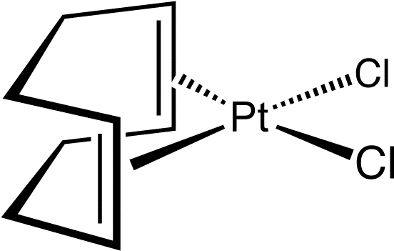
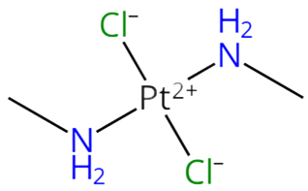
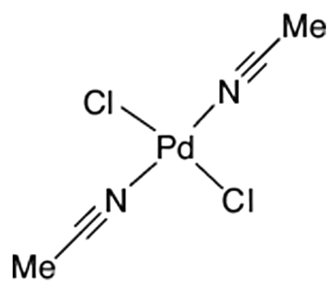
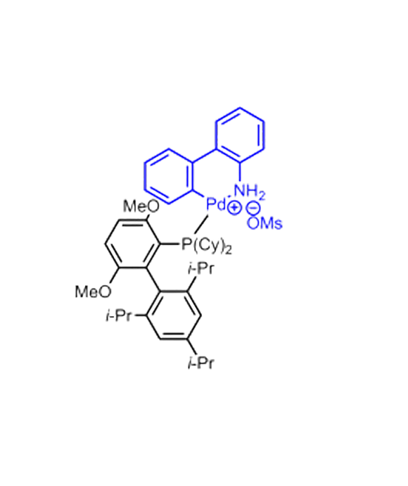
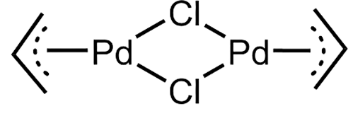
Explore
Five organometallic molecules with experimental data
(1,5-COD)PtCl₂
Dichloro(1,5-cyclooctadiene)platinum
(MeNH₂)₂PtCl₂
cis-Dichlorobis(methylamine)platinum
Pd Allyl Chloride Dimer
Di-μ-chlorobis(η³-2-propenyl)dipalladium
(MeCN)₂PdCl₂
Bis(acetonitrile)dichloropalladium (II)
Gen 3 BrettPhos

Slide 8
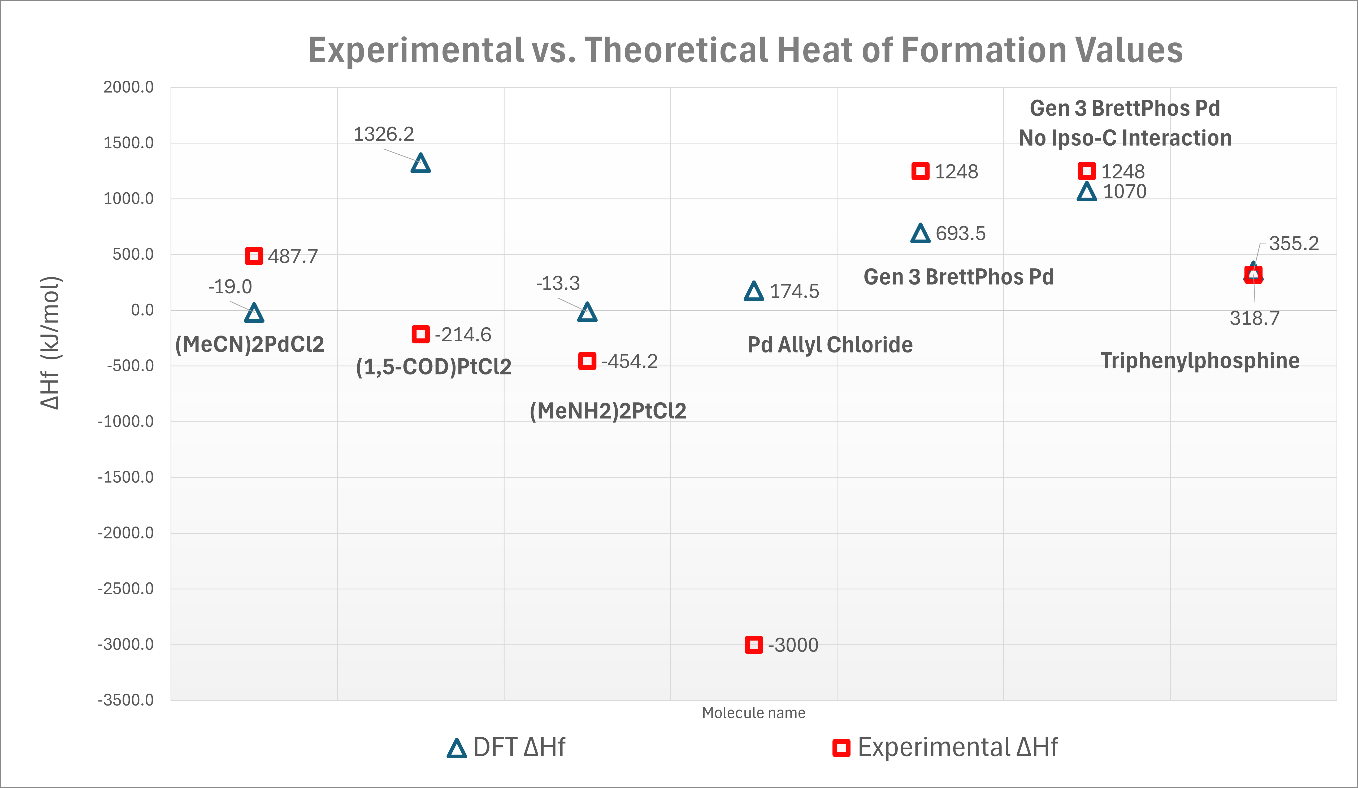
Computation- ΔH_{f} Results

Slide 9
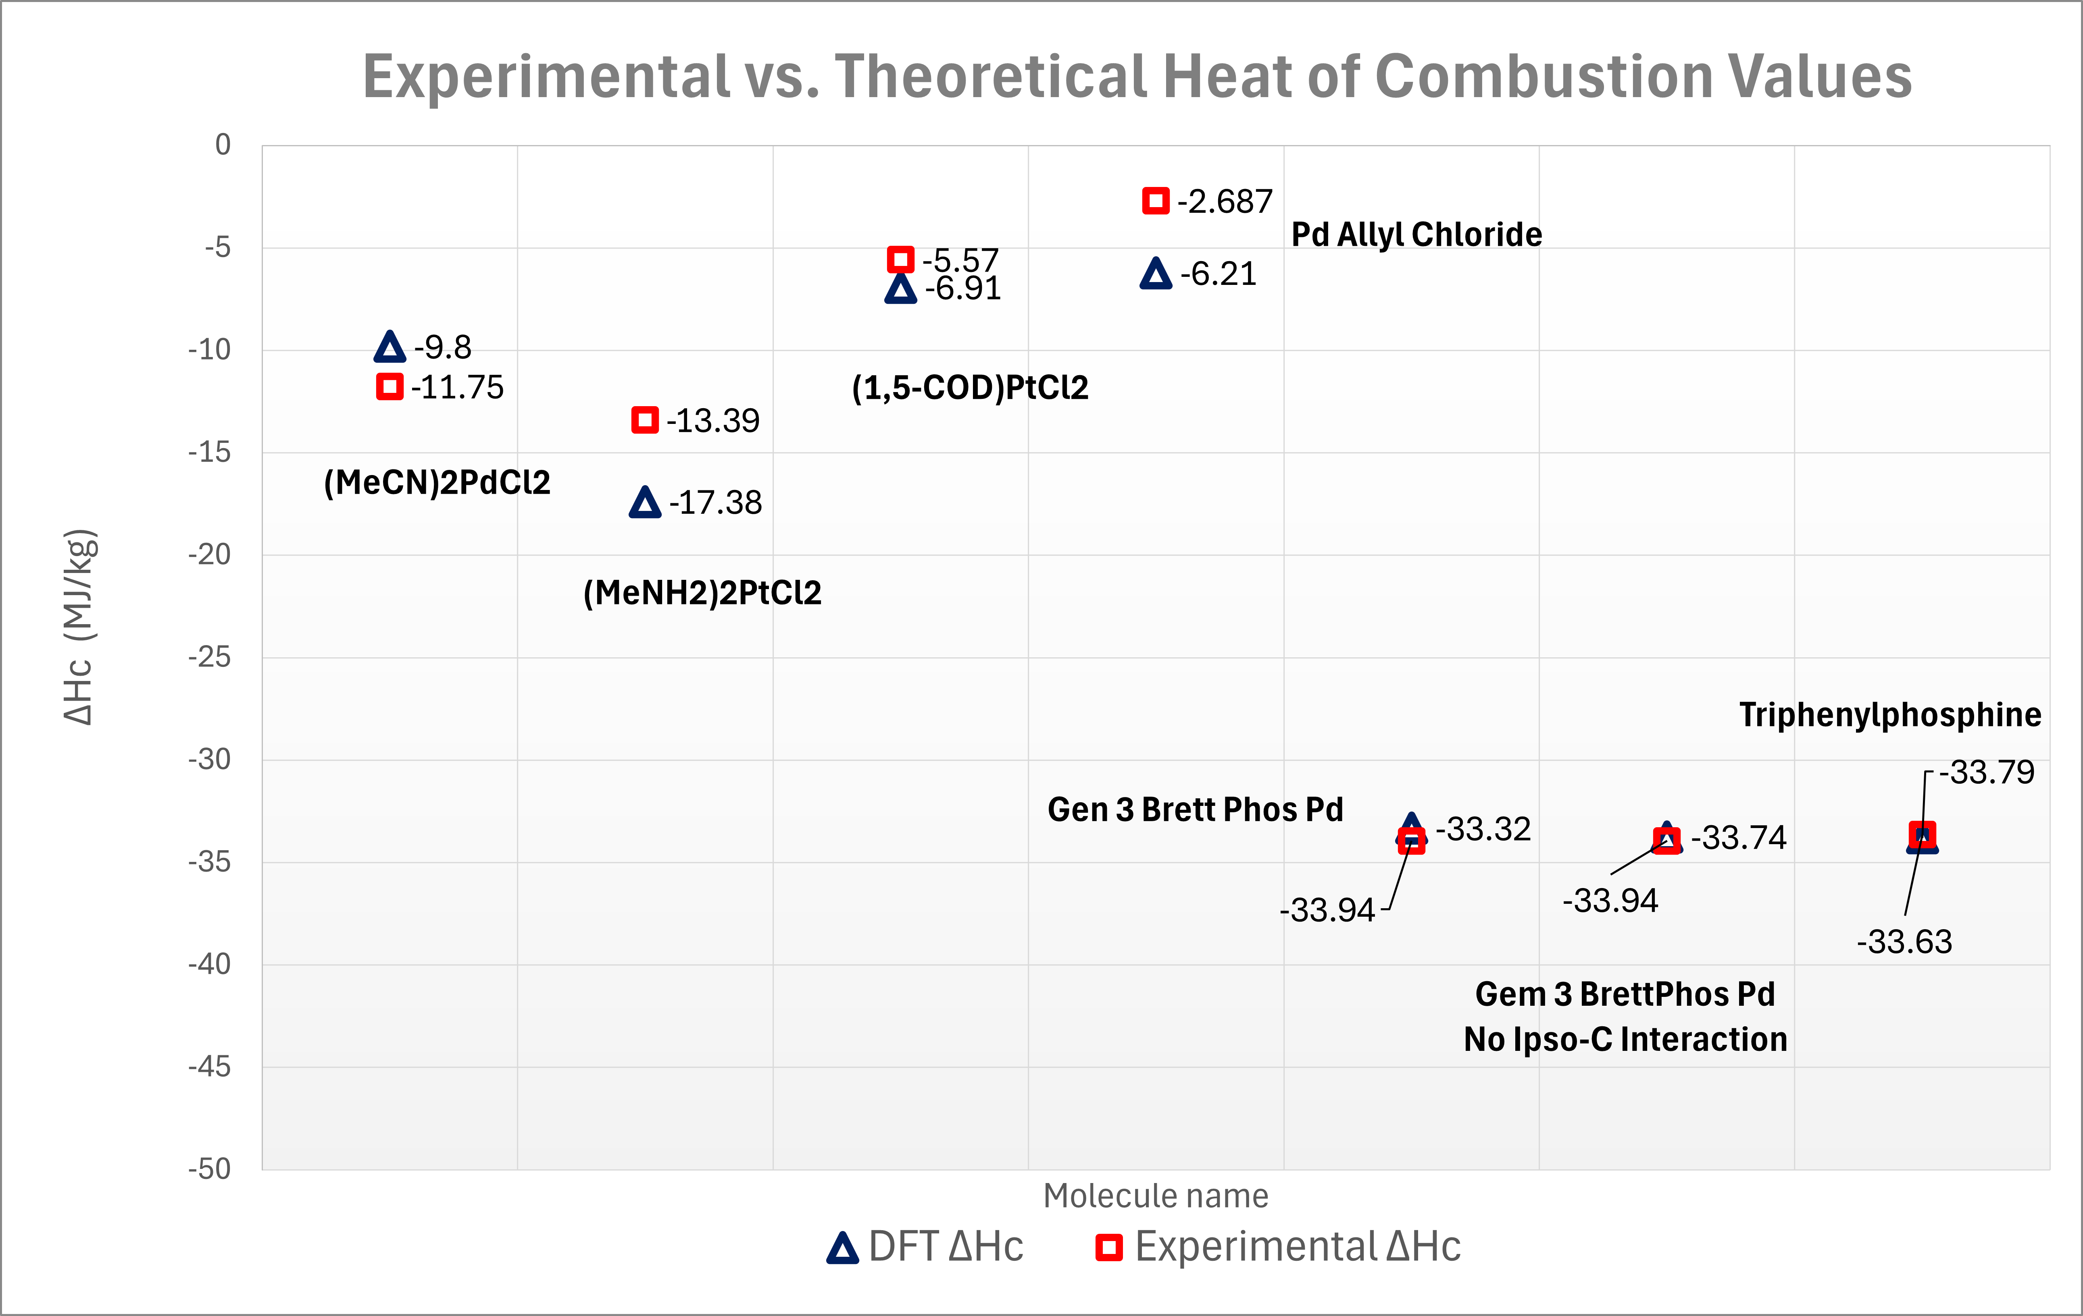
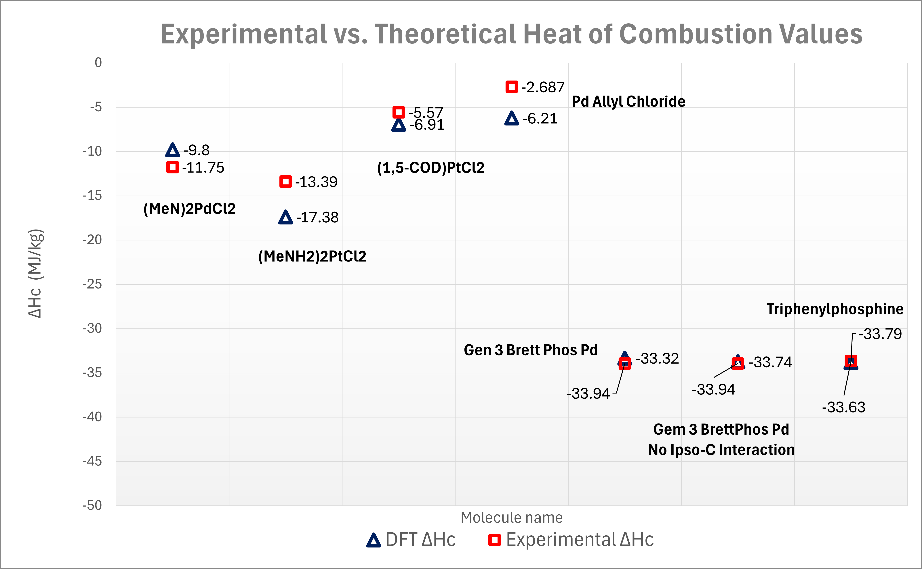
Computation- ΔH_{c} Results

Slide 10
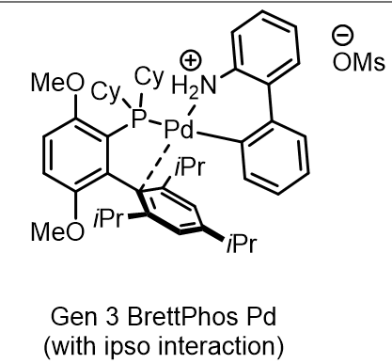
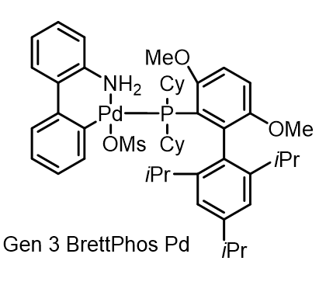
Gen 3 BrettPhos – Case Study
The Best Result from this Study
Molecule is extremely bulky and did not run correctly
1. All cyclohexane rings substituted for methyl groups
2. All isopropyl groups eliminated
2nd Run: 44% error ΔHf, 1.8% error ΔHc
3. Removed an Ipso Carbon Interaction
3rd Run: 14% error ΔHf, 0.5% error ΔHc

Slide 11
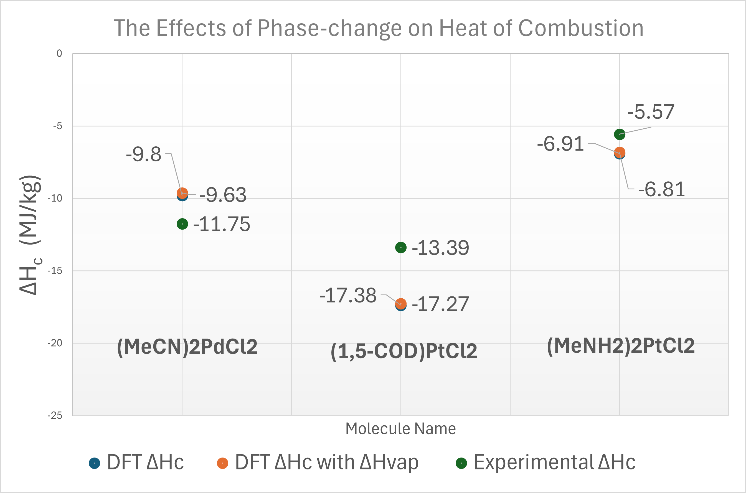
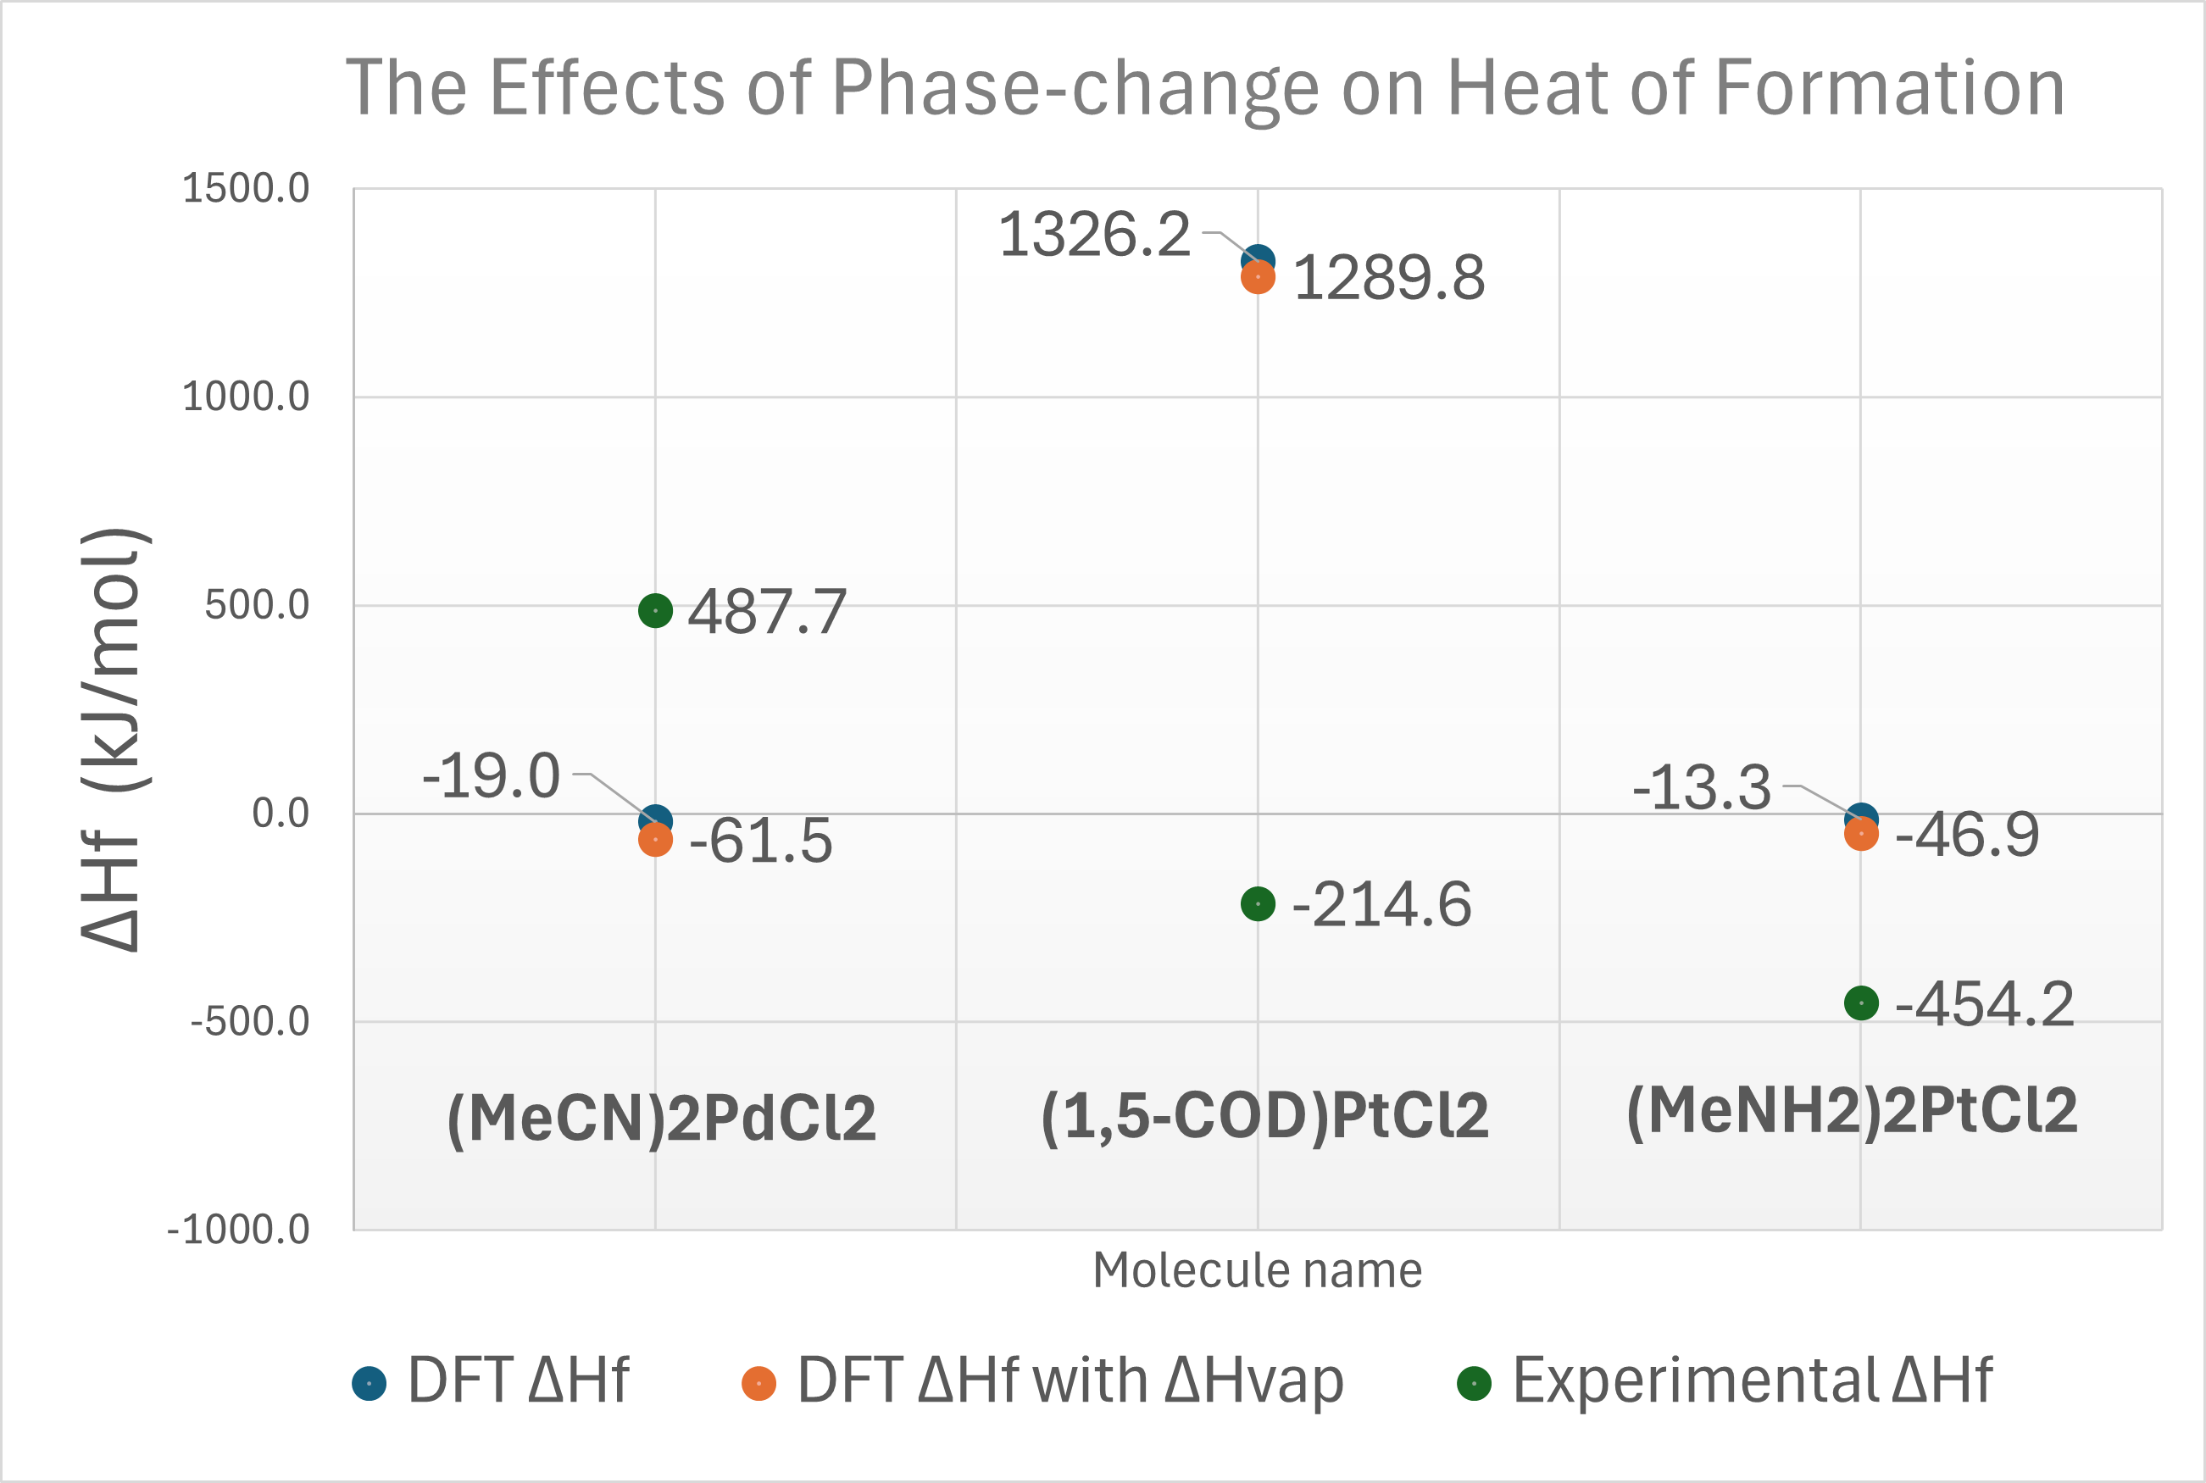
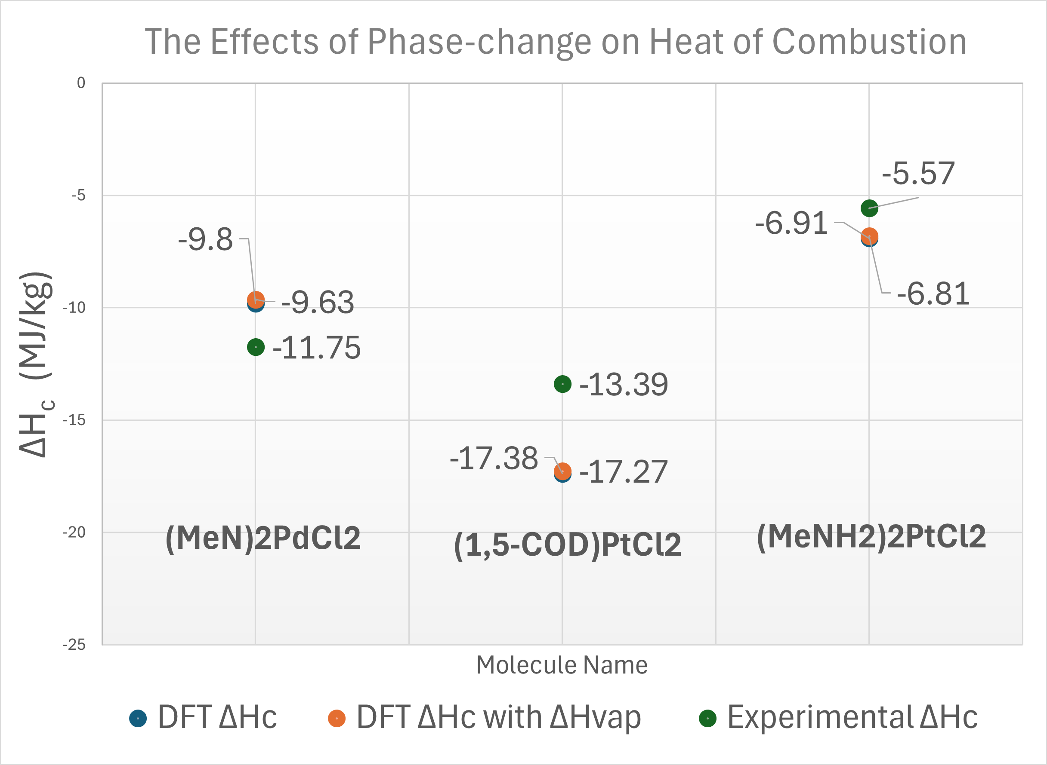
Analysis- The Effects of Phase-change Enthalpy
Exactly how much does ΔH_{vap} contribute to error?
ΔH_{vap} contributes very little to the errors observed!

Slide 12


Analysis- Conservativeness of Results
An ideal tool is accurate. A safe tool overestimates.
Of the five molecules with experimental data:
DFT provided overestimation of ΔH_{c} in three cases
One example of underestimation
One example of near-perfect agreement
DFT demonstrates a tendency toward conservative estimation, but is not fully consistent

Slide 13
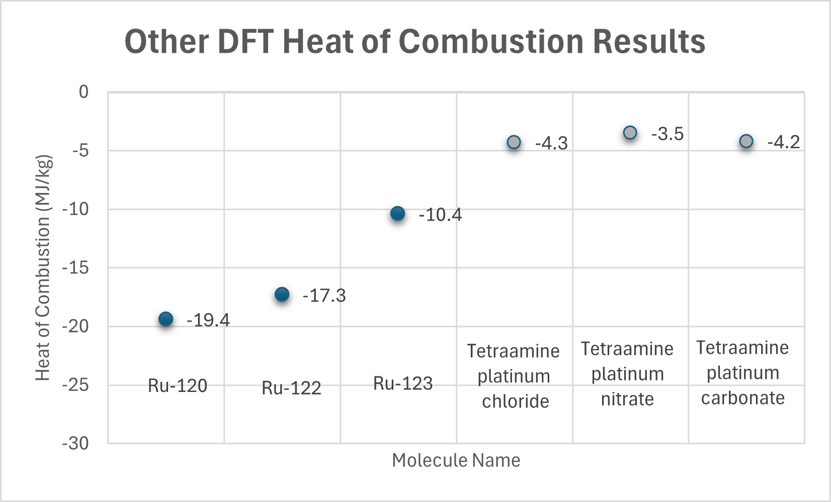
Results of other Molecules Studied

Slide 14
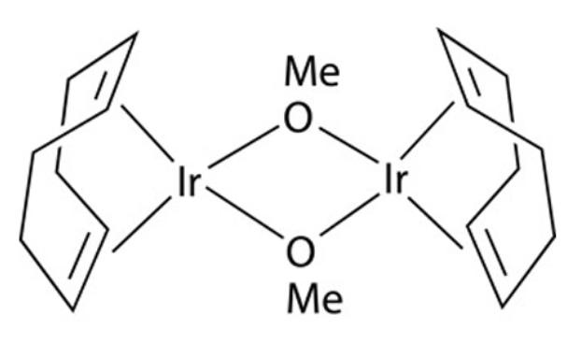
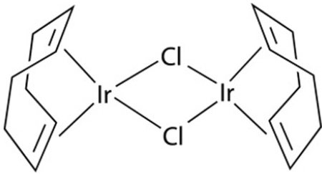
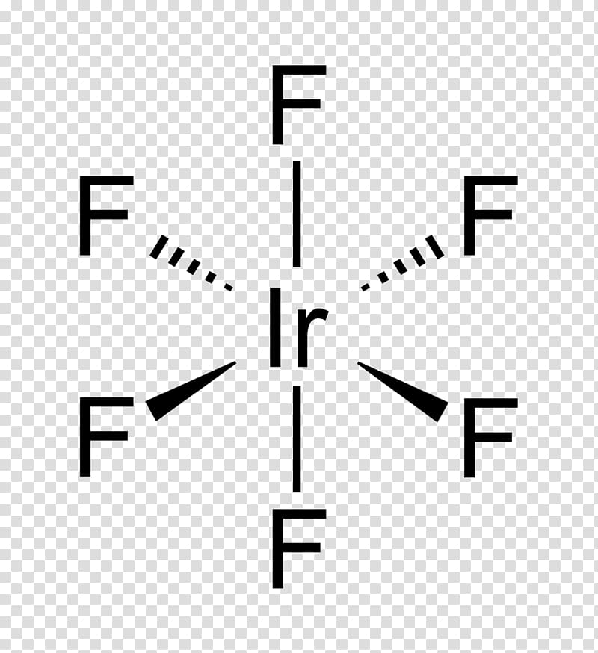
Iridium Errors
All Iridium-containing molecules resulted in output values blown out of proportion
May have resulted from poor basis set assumptions or coding errors in the workflow
Similar errors occurred when molecules were too large, causing computations to time out
Molecule Name and Structure | DFT ΔH_{f} Estimate (kJ/mol)
Ir-92 | 2,741,097
Ir-93 | 4,553,551
Iridium Hexafluoride | 1,821,324 (~10⁵ x the experimental value)

Slide 15
Where Does DFT Show Promise?
Heat of Combustion ΔH_{c} Predictions
Showcased better agreement than ΔH_{f} predictions
Palladium-based molecules- best agreement
Ligand-Dominated Molecules
Combustion product ΔH_{f} are well-studied
Gen 3 Brett Phos – 0.57% error
3. Process Safety
DFT results skewed towards conservative estimation

Slide 16
Challenges with DFT
Heat of Formation (ΔH_{f} ) Predictions
Significant deviation from experimental values
Inconsistent magnitude and sign
Inconsistent Transition Metal Modeling
Palladium (best) > Platinum > Ruthenium >>> Iridium (worst)
Incomplete Handling of Intermolecular Interactions
Ex: Ipso-carbon interaction on 3rd Gen BrettPhos
Solid-state interactions, crystallization energy, vaporization energy

Slide 17
Key Takeaways
DFT showed mixed accuracy across the molecules studied
ΔH_{c} predictions are generally more reliable than ΔH_{f}
Large deviations in ΔH_{f} highlight limitations in quantum modeling of organometallics
The method produced some conservative estimates, but not consistently
Performance is highly molecule-dependent, with worse results for certain metal centers and ligands

Slide 18
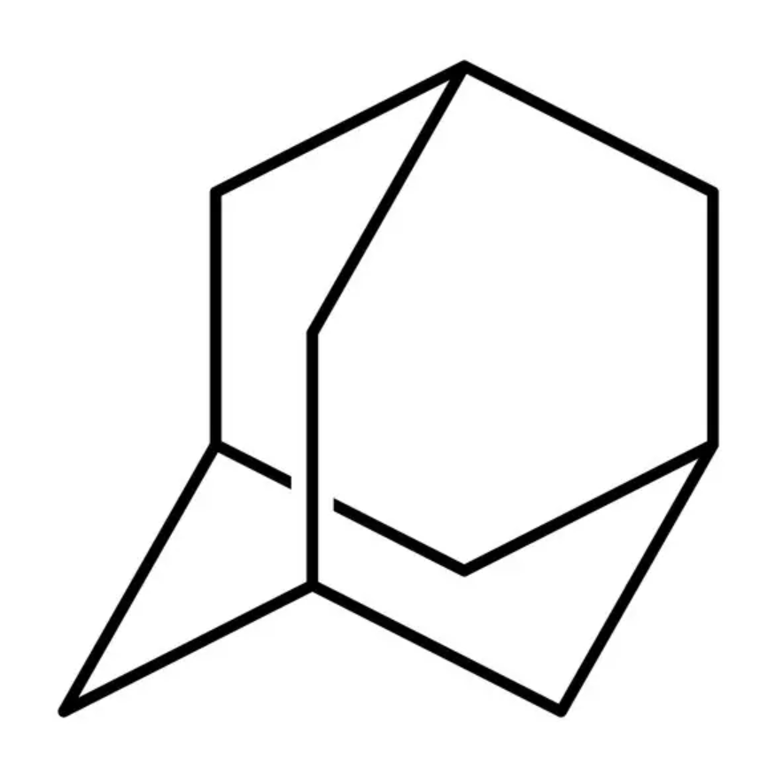
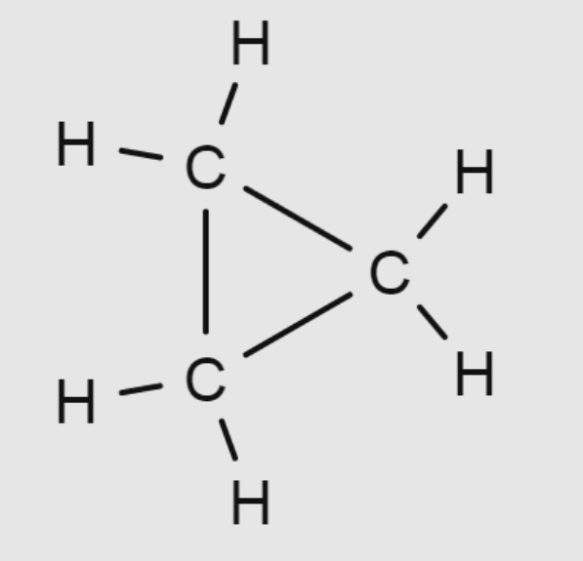
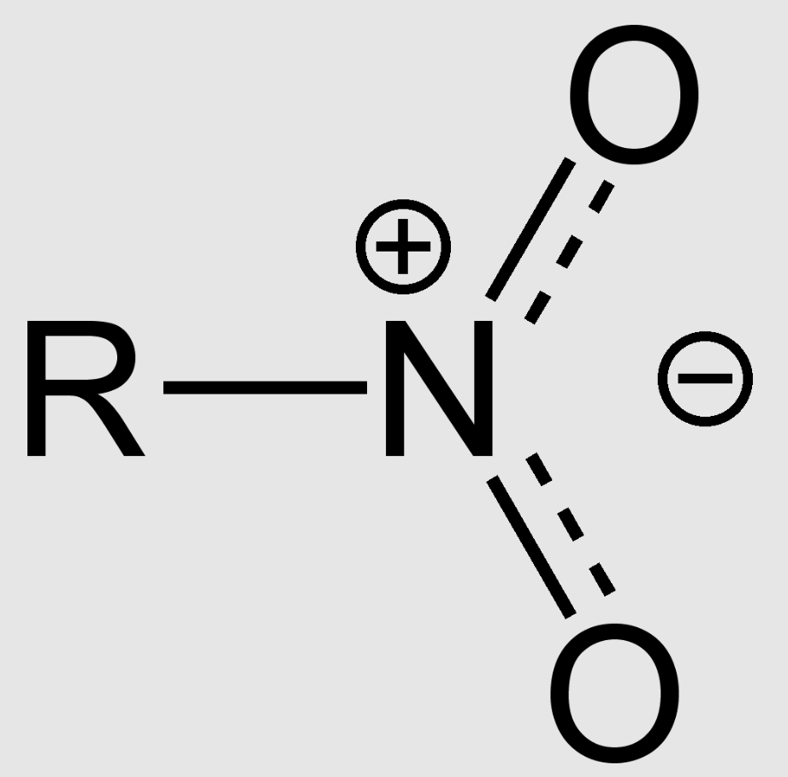
Future Work
Improve Accuracy for Iridium Molecules
Hybrid Modeling Strategy
Expand Dataset
Improve Practical Relevance
-Test alternative basis sets
-Relativistic corrections
-Validation against experimental data
-Using G4 for ligands, DFT for metal centers
-Reduce cost & improve accuracy
-Target high energy functional groups
(nitro, small carbocycles, adamantane, etc.)
-Find more experimental data
-Implement automatic ΔH_{vap}​ incorporation
-Align DFT output with experimental data
Friendly Cheat Sheet!
Adamantane
Small Carbocycle
Nitro Group
Notes:
Pause at cheat sheet to list which molecule is which.

Slide 19
Global Conclusion
DFT is a useful tool but is not currently a standalone solution for thermochemical prediction in organometallic systems.

Slide 20
Acknowledgements
-Dr. Robert Higgins, Process Safety Chemist at Johnson Matthey
-Dr. Robert Woodman, Process Safety Leader at Johnson Matthey
-Dr. Ray Mentzer, Research Advisor
-Tyler Pasut, Savoie PhD Student

Slide 21
Thank You Questions?

Slide 22












Design Elements
Copy and paste as needed. Delete slide before presenting.

